Slide 1


Cleiton Otavio da Exaltação Rocha
25/12/2021

Slide 2

Outline
Executive Summary
Introduction
Methodology
Results
Conclusion
Appendix

Slide 3
Executive Summary
Summary of methodologies
Summary of all results

Slide 4
Introduction
Project background and context
Problems you want to find answers

Slide 5


Slide 6
Methodology
Executive Summary
Data collection methodology:
Describe how data was collected
Perform data wrangling
Describe how data was processed
Perform exploratory data analysis (EDA) using visualization and SQL
Perform interactive visual analytics using Folium and Plotly Dash
Perform predictive analysis using classification models
How to build, tune, evaluate classification models

Slide 7
Data Collection
Data were collected through two processes: 1) Webscrapping, where in this case information from a website is collected, stored and later analyzed and 2) through an API, which in short is a program that bridges the gap between the data request and its source.
1 – Webscrapping
2 – API

Slide 8
Data Collection – SpaceX API
A request of type 'GET' is made to get the information back in a JSON format. After that, the JSON is transformed into a dataframe in Pandas format, ready for analysis
https://github.com/CleitonOERocha/IBM_DS_Final_Project/blob/main/jupyter-labs-spacex-data-collection-api.ipynb
1 – Link:
spacex_url="https://api.spacexdata.com/v4/launches/past"
2 – GET Requistion:
response = requests.get(spacex_url)
3 – json_normalize:
data = pd.json_normalize(response.json())

Slide 9
Data Collection - Scraping
1 – Link:
static_url="https://en.wikipedia.org/w/index.php?title=List_of_Falcon_9_and_Falcon_Heavy_launches&oldid=1027686922"
Present your web scraping process using key phrases and flowcharts
https://github.com/CleitonOERocha/IBM_DS_Final_Project/blob/main/jupyter-labs-webscraping.ipynb
2 – GET Requisition:
response = requests.get(static_url)
3 – Transform in list:
soup = BeautifulSoup(response.text, "html.parser")
4 – Transform in df:
html_tables = soup.find_all('table')

Slide 10
Data Wrangling
The first step is to load the data using the Pandas 'read_csv' function. After that, some information is extracted from the dataset, namely: 1) the percentage of missing values in each column was calculated. 2) the number of launches at each site was calculated 3) the number and occurrence of the mission result by orbit type was calculated and 4) a landing result label was created in the 'Result' column
https://github.com/CleitonOERocha/IBM_DS_Final_Project/blob/main/labs-jupyter-spacex-Data%20wrangling.ipynb
1 – Link:
df=pd.read_csv("https://cf-courses-data.s3.us.cloud-object-storage.appdomain.cloud/IBM-DS0321EN-SkillsNetwork/datasets/dataset_part_1.csv")
2 – NA Count:
df.isnull().sum()/df.count()*100
3 – Orbit count:
df["Orbit"].value_counts()
4 – Outcome count:
landing_outcomes = df["Outcome"].value_counts()
5 – Outcome Condition:
landing_class = np.where(df["Outcome"] == bad_outcomes, 0, 1)

Slide 11
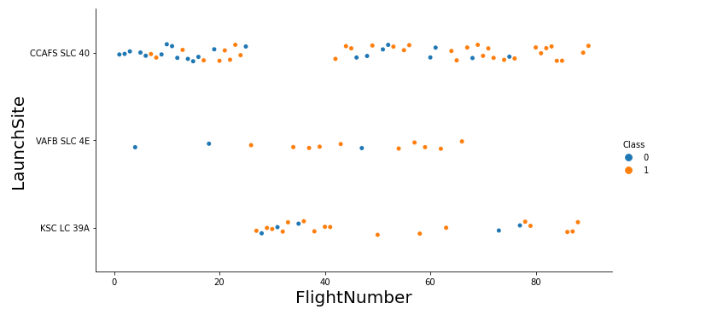
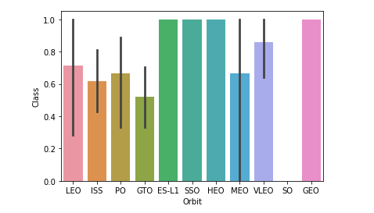
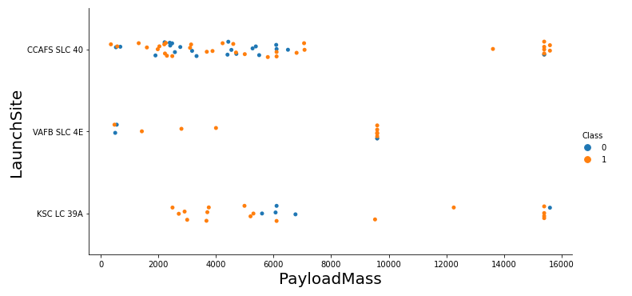
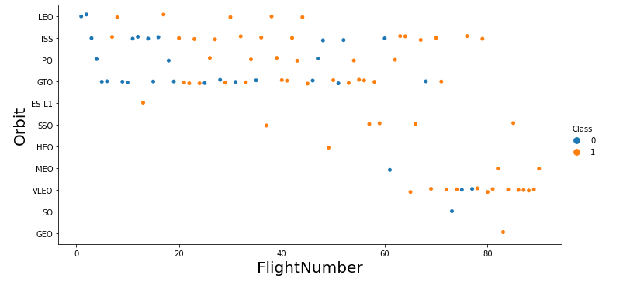
EDA with Data Visualization
The generated graphics serve to understand more quickly some relevant information about the rockets, such as mission success, mass loss, etc.
https://github.com/CleitonOERocha/IBM_DS_Final_Project/blob/main/jupyter-labs-eda-dataviz.ipynb

Slide 12
EDA with SQL
The queries performed were to select variables, group, summarize, filter, among others; Queries are performed using SQL queries through the pandas sql package.
https://github.com/CleitonOERocha/IBM_DS_Final_Project/blob/main/jupyter-labs-eda-sql-coursera.ipynb
SELECT
WHERE
GROUP BY
SUM
COUNT
AVERAGE

Slide 13
Build an Interactive Map with Folium
Summarize what map objects such as markers, circles, lines, etc. you created and added to a folium map
Explain why you added those objects
https://github.com/CleitonOERocha/IBM_DS_Final_Project/blob/main/lab_jupyter_launch_site_location%20(1).ipynb

Slide 14
Build a Dashboard with Plotly Dash
Summarize what plots/graphs and interactions you have added to a dashboard
Explain why you added those plots and interactions
Add the GitHub URL of your completed Plotly Dash lab, as an external reference and peer-review purpose

Slide 15
Predictive Analysis (Classification)
1 – Load dataframe:
data = pd.read_csv("https://cf-courses-data.s3.us.cloud-object-storage.appdomain.cloud/IBM-DS0321EN-SkillsNetwork/datasets/dataset_part_2.csv")
The models were built from the sklearn library, each model is built and its results tested to see if the model has good accuracy. The best model is the one with the best accuracy.
https://github.com/CleitonOERocha/IBM_DS_Final_Project/blob/main/SpaceX_Machine%20Learning%20Prediction_Part_5.ipynb
2 – Split in train and test:
X_train, X_test, Y_train, Y_test = train_test_split(X, Y, test_size=0.2, random_state = 2)
3 – Model:
logreg_cv = GridSearchCV(lr, parameters, cv = 10)
4 – Fit model:
logreg_cv.fit(X_train, Y_train)
5 – Accuracy:
print("Tuned Logistic Regression Parameter: {}".format(logreg_cv.best_params_))
print("Tuned Logistic Regression Accuracy: {}".format(logreg_cv.best_score_))

Slide 16
Results
Exploratory data analysis results
Interactive analytics demo in screenshots
Predictive analysis results

Slide 17


Slide 18
Flight Number vs. Launch Site
Show a scatter plot of Flight Number vs. Launch Site
Show the screenshot of the scatter plot with explanations

Slide 19
Payload vs. Launch Site
Show a scatter plot of Payload vs. Launch Site
Show the screenshot of the scatter plot with explanations

Slide 20
Success Rate vs. Orbit Type
Show a bar chart for the success rate of each orbit type
Show the screenshot of the scatter plot with explanations

Slide 21
Flight Number vs. Orbit Type
Show a scatter point of Flight number vs. Orbit type
Show the screenshot of the scatter plot with explanations

Slide 22
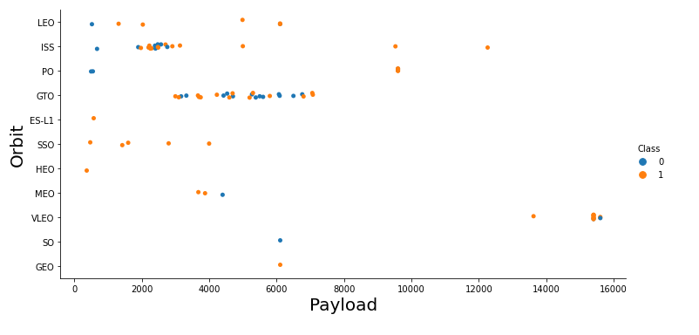
Payload vs. Orbit Type
Show a scatter point of payload vs. orbit type
Show the screenshot of the scatter plot with explanations

Slide 23
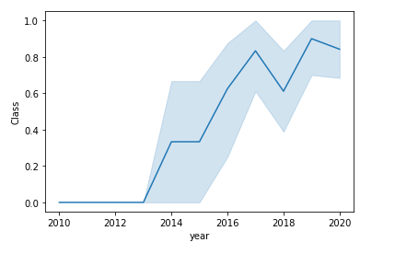
Launch Success Yearly Trend
Show a line chart of yearly average success rate
Show the screenshot of the scatter plot with explanations

Slide 24
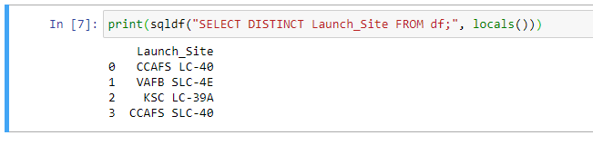
All Launch Site Names
Find the names of the unique launch sites
Present your query result with a short explanation here

Slide 25
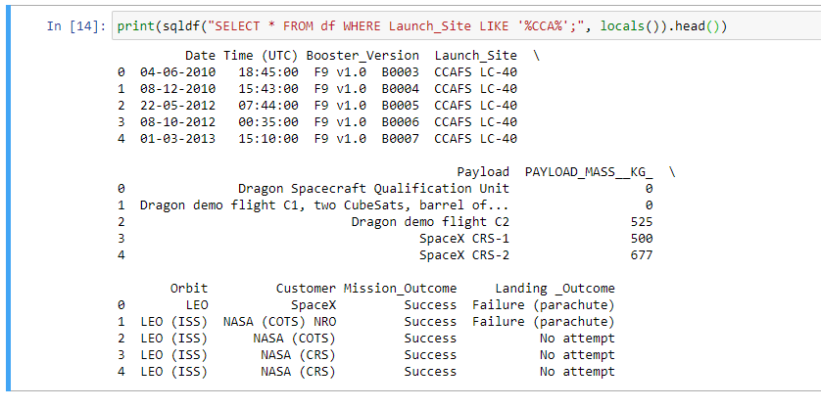
Launch Site Names Begin with 'CCA'
Find 5 records where launch sites begin with `CCA`
Present your query result with a short explanation here

Slide 26
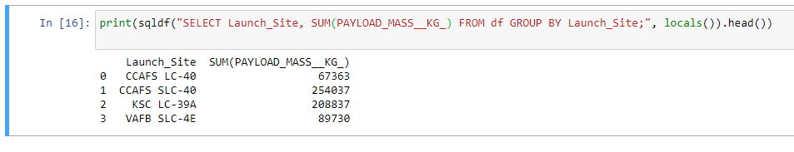
Total Payload Mass
Calculate the total payload carried by boosters from NASA
Present your query result with a short explanation here

Slide 27
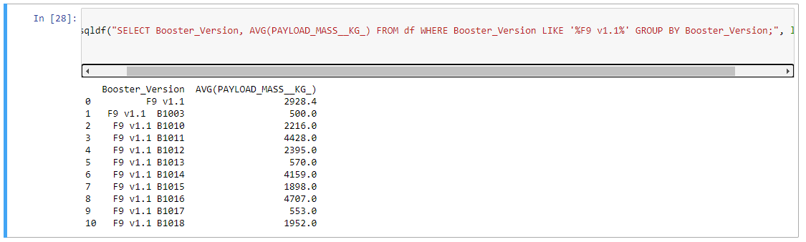
Average Payload Mass by F9 v1.1
Calculate the average payload mass carried by booster version F9 v1.1
Present your query result with a short explanation here

Slide 28
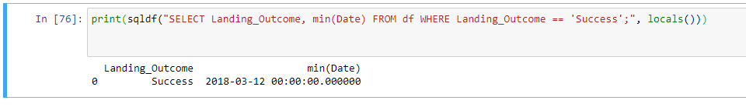
First Successful Ground Landing Date
Find the dates of the first successful landing outcome on ground pad
Present your query result with a short explanation here

Slide 29
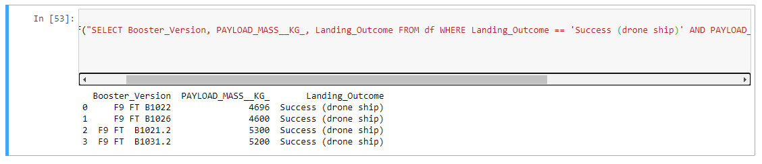
Successful Drone Ship Landing with Payload between 4000 and 6000
List the names of boosters which have successfully landed on drone ship and had payload mass greater than 4000 but less than 6000
Present your query result with a short explanation here

Slide 30
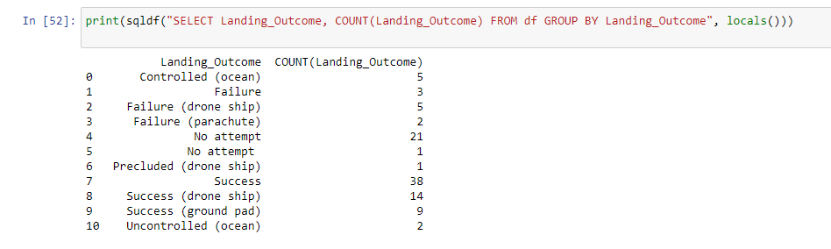
Total Number of Successful and Failure Mission Outcomes
Calculate the total number of successful and failure mission outcomes
Present your query result with a short explanation here

Slide 31
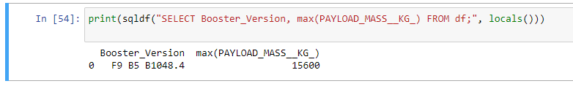
Boosters Carried Maximum Payload
List the names of the booster which have carried the maximum payload mass
Present your query result with a short explanation here

Slide 32
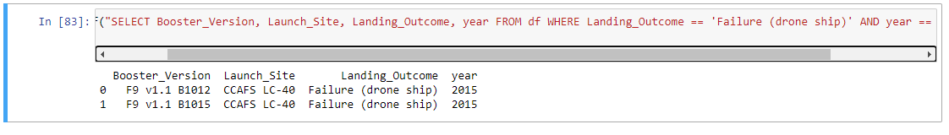
2015 Launch Records
List the failed landing_outcomes in drone ship, their booster versions, and launch site names for in year 2015
Present your query result with a short explanation here

Slide 33
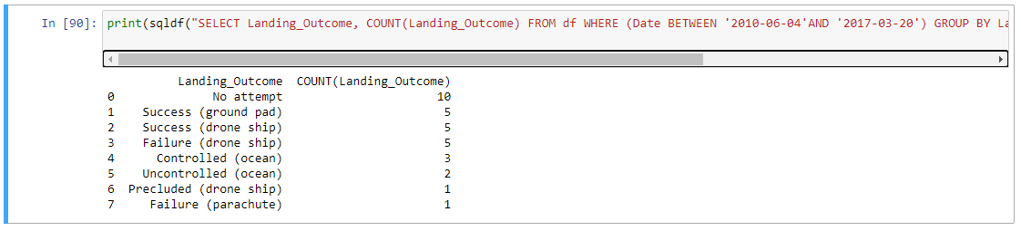
Rank Landing Outcomes Between 2010-06-04 and 2017-03-20
Rank the count of landing outcomes (such as Failure (drone ship) or Success (ground pad)) between the date 2010-06-04 and 2017-03-20, in descending order
Present your query result with a short explanation here

Slide 34


Slide 35
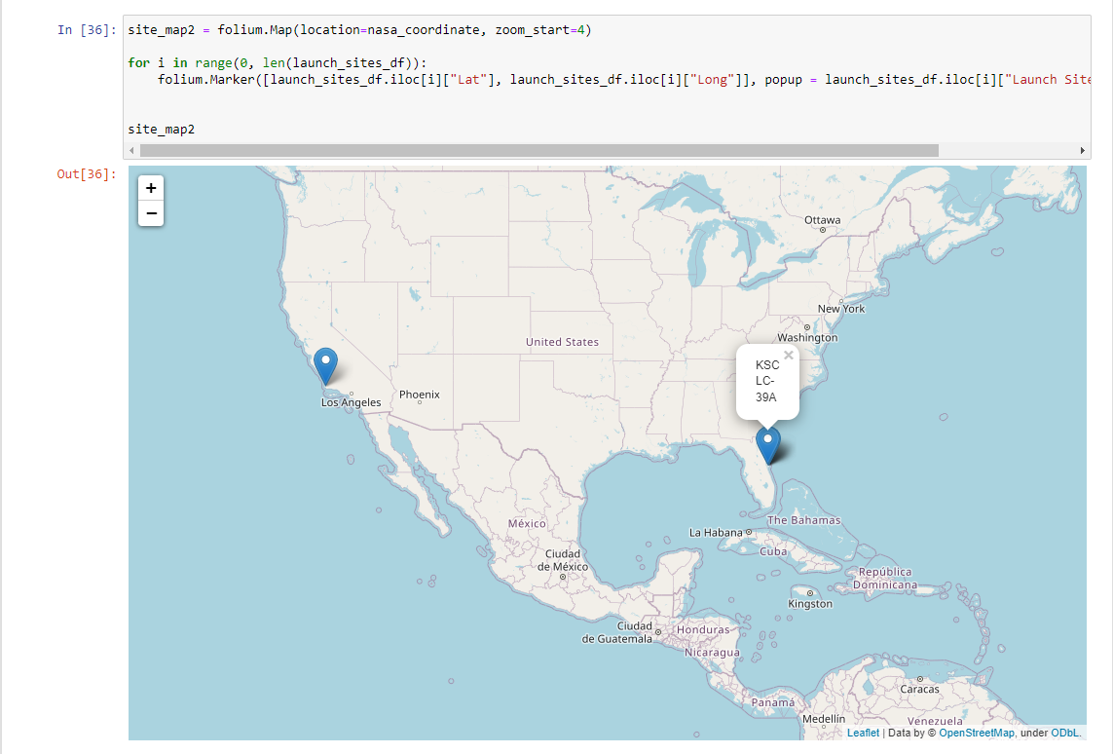
<Folium Map Screenshot 1>
Replace <Folium map screenshot 1> title with an appropriate title
Explore the generated folium map and make a proper screenshot to include all launch sites’ location markers on a global map
Explain the important elements and findings on the screenshot

Slide 36
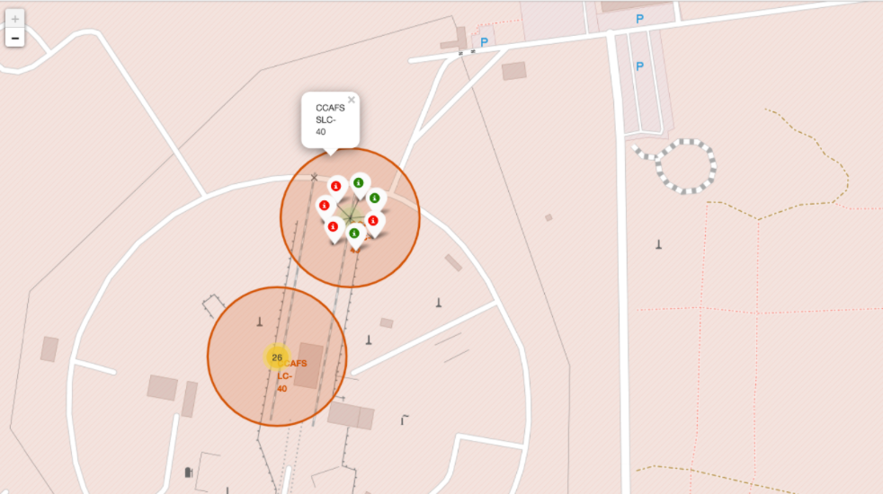
<Folium Map Screenshot 2>
Replace <Folium map screenshot 2> title with an appropriate title
Explore the folium map and make a proper screenshot to show the color-labeled launch outcomes on the map
Explain the important elements and findings on the screenshot

Slide 37

<Folium Map Screenshot 3>
Replace <Folium map screenshot 3> title with an appropriate title
Explore the generated folium map and show the screenshot of a selected launch site to its proximities such as railway, highway, coastline, with distance calculated and displayed
Explain the important elements and findings on the screenshot

Slide 38


Slide 39
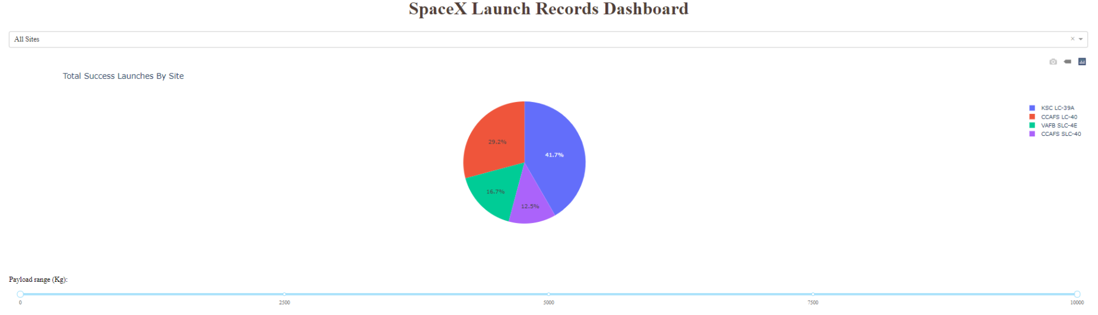
<Dashboard Screenshot 1>
Replace <Dashboard screenshot 1> title with an appropriate title
Show the screenshot of launch success count for all sites, in a piechart
Explain the important elements and findings on the screenshot

Slide 40
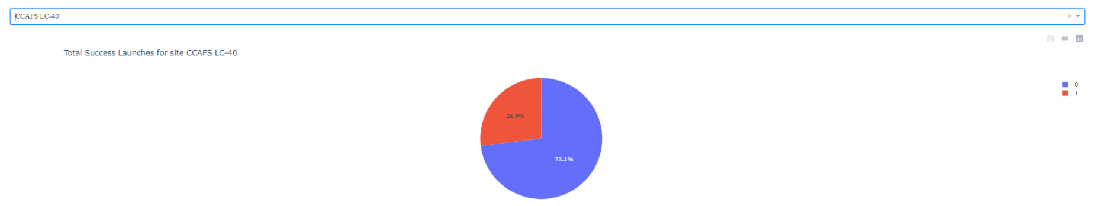
<Dashboard Screenshot 2>
Replace <Dashboard screenshot 2> title with an appropriate title
Show the screenshot of the piechart for the launch site with highest launch success ratio
Explain the important elements and findings on the screenshot

Slide 41
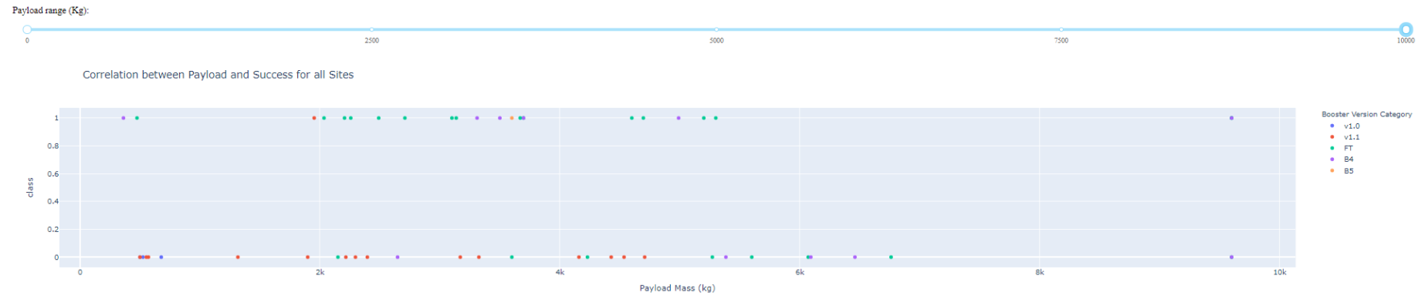
<Dashboard Screenshot 3>
Replace <Dashboard screenshot 3> title with an appropriate title
Show screenshots of Payload vs. Launch Outcome scatter plot for all sites, with different payload selected in the range slider
Explain the important elements and findings on the screenshot, such as which payload range or booster version have the largest success rate, etc.

Slide 42


Slide 43
Classification Accuracy
Visualize the built model accuracy for all built classification models, in a bar chart
Find which model has the highest classification accuracy

Slide 44
Confusion Matrix
Show the confusion matrix of the best performing model with an explanation

Slide 45
Conclusions
Point 1
Point 2
Point 3
Point 4
…

Slide 46
Appendix
Include any relevant assets like Python code snippets, SQL queries, charts, Notebook outputs, or data sets that you may have created during this project

Slide 47


